Slide 1
Project on Card Game
Functionality Implementation of Card Game:
Following are the major functionality units which includes following classes:
Card
Deck
Hand
ClassManager
Player
Round
RenderableCard
CardMesh
Seriazlizable (saving and loading)
Console
NormalAIPlayer
HumanPlayer
GameApplication
n) GameGraphics
Trump Suit:
Following are the additional classes:
TrumpGameManager
TrumpAiPlayer

Slide 2
FILE FORMAT
SAVE And LOAD:
All classes which require saving and loading inherit from CSerializable class which has 2 pure virtual methods: Read and Write.
FILE FORMAT:
<Player data>
NAME
ROUNDS WON
GAMES WON
<Hand Data>
Is trump game flag
(Trump suit and Trump selection phase flag) for Trump game only
Magic number 1023
Number of Rounds
Current player to move
Game Status
Number of Players
<Player Data>
Number of rounds played
<Rounds Data>
<Rounds Data>
Number Of moves
<Card data>
Player Name
<Hand Data>
Number Of Cards
<Card Data>
<Card Data>
Suit
Value

Slide 3
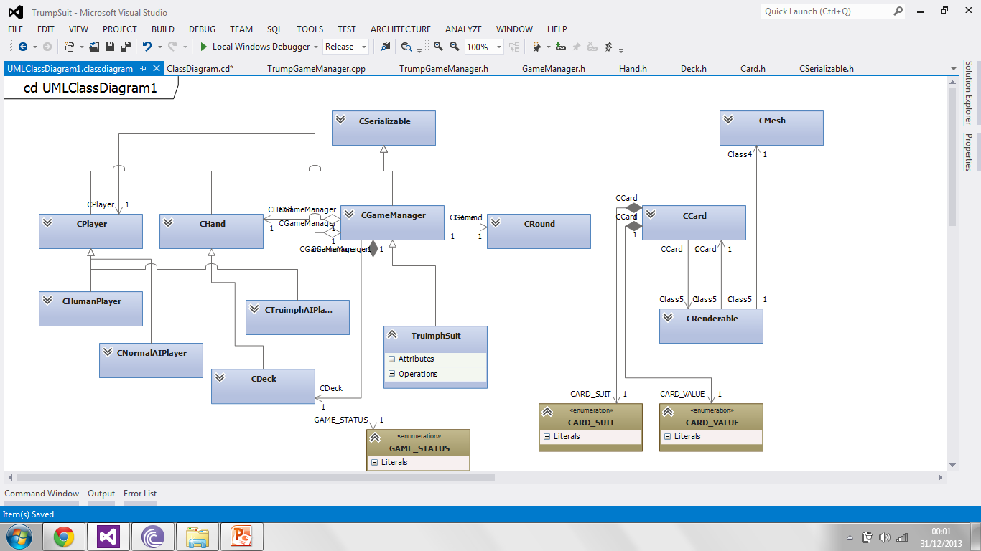

Slide 4
Graphical User Interface
Win32 windows application.
Utilizes Direct3D 11 to render graphics.
Direct 3D provides abstraction of graphics hardware.
Different resources (Buffers, Textures) and shaders (Vertex, Pixel, …) are the working horse of Direct 3D.
Graphics framework mainly abstracts resource management and user interface.
User interface custom made using direct3d resources. Interaction is made by handing windows messages.

